Slide 1
Clustering in machine learning
Clustering is a data science technique in machine learning that groups similar rows in a data set. After running a clustering technique, a new column appears in the data set to indicate the group each row of data fits into best.

Slide 2
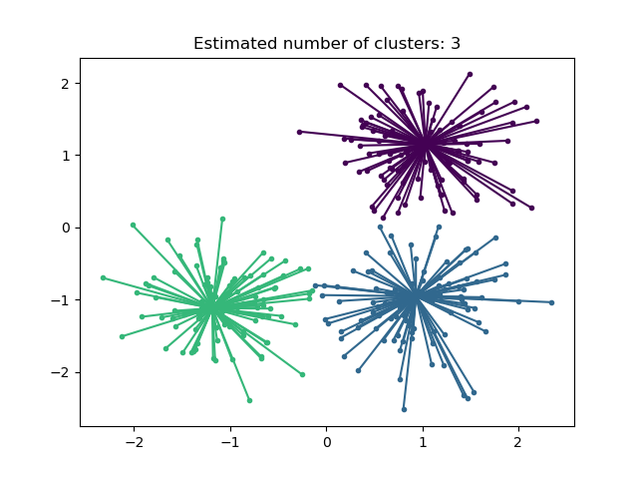
Affinity Propagation from sklearn.cluster import AffinityPropagation
Aff= AffinityPropagation(random_state=5) y_Aff=Aff.fit_predict(X)
It’s creates clusters by sending messages between pairs of samples until convergence.
A dataset is then described using a small number of exemplars.
which are identified as those most representative of other samples. The messages sent between pairs represent the suitability for one sample to be the exemplar of the other, Which is updated in response to the values from other pairs.

Slide 3
This updating happens iteratively until convergence, at which point the final exemplars are chosen, and hence the final clustering is given.
The two important parameters:
which controls how many exemplars are used.
The damping factor which damps the responsibility and availability messages to avoid numerical oscillations when updating these messages.
Drawback of Affinity Propagation is its complexity.
The algorithm has a time complexity of the order O(N2T)
This makes Affinity Propagation most appropriate for small to medium sized datasets.

Slide 4
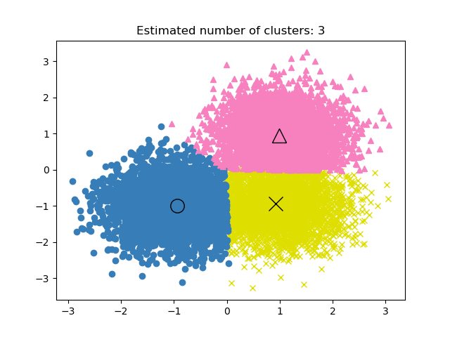
Mean Shift clustering aims to discover blobs in a smooth density of samples.
It is a centroid based algorithm, which works by updating candidates for centroids to be the mean of the points within a given region.
These candidates are then filtered in a post-processing stage to eliminate near-duplicates to form the final set of centroids.
The position of centroid candidates is iteratively adjusted using a technique called hill climbing.
MEAN SHIFT CLUSTERING
from sklearn.cluster import MeanShift
Mean shift5 = MeanShift(bandwidth=2)
Y_mean shift=mean shift.fit_predict(X)

Slide 5
mean shift vector that is computed for each centroid that points towards a region of the maximum increase in the density of points.
Effectively updating a centroid to be the mean of the samples within its neighborhood:
Advantage
The algorithm automatically sets the number of clusters, instead of relying on a parameter bandwidth
This parameter can be set manually, but can be estimated using The provided estimate_bandwidth function, which is called if the bandwidth is not set.
Disadvantage
The algorithm is not highly scalable
The algorithm will stop iterating when the change in centroids is small.

Slide 6
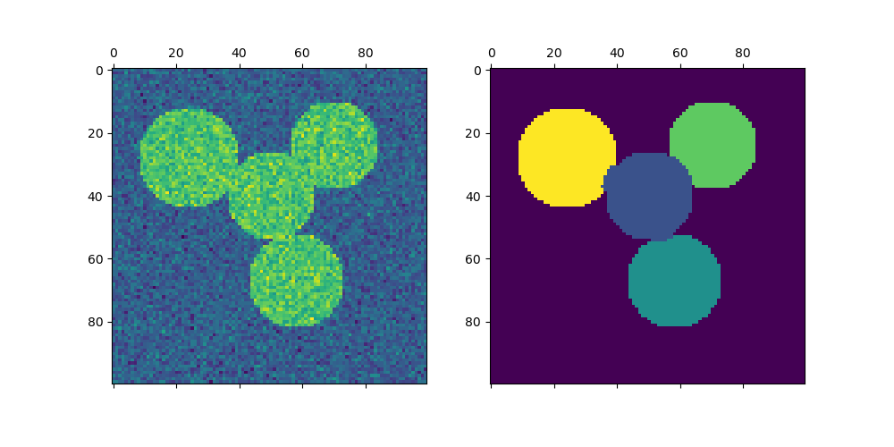
Spectral clustering performs a low-dimension embedding of the affinity matrix between samples.
K_means, of the components of the eigenvectors in the low dimensional space. it is especially computationally efficient if the affinity matrix is sparse and the amg. it works well for a small number of clusters, but is not advised for many clusters.
Two clusters, spectralclustering solves a convex relaxation of the normalized cuts problem on the similarity graph.
Spectral clustering
from sklearn.cluster import SpectralClustering
spe= SpectralClustering(n_clusters=2,assign_labels='discretize', random_state=0)
Y_spe=spe.fit_predict(X

Slide 7
cutting the graph in two so that the weight of the edges cut is small compared to the weights of the edges inside each cluster.
This criteria is especially interesting when working on images, where graph vertices are pixels, and weights of the edges of the similarity graph are computed using a function of a gradient of the image.

Slide 8
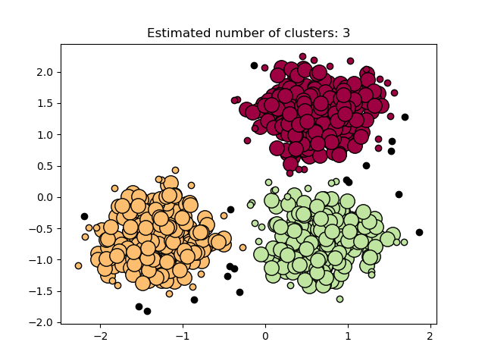
The dbscan algorithm views clusters as areas of high density separated by areas of low density
Dbscan can be any shape, as opposed to k-means which assumes that clusters are convex shaped.
The central component to the dbscan is the concept of core samples which are samples that are in areas of high density. a cluster is therefore a set of core samples, each close to each other.
DBSCAN CLUSTERING
from sklearn.cluster import DBSCAN
dbsc= DBSCAN(eps=3, min_samples=2)
Y_dbsc=dbsc.fit_predict(X)

Slide 9
There are two parameters to the algorithm
min_samples and eps :
Higher min_samples or lower eps indicate higher density necessary to form a cluster.
the parameter min_samples primarily controls how tolerant the algorithm is towards noise
the parameter eps is crucial to choose appropriately for the data set and distance function and usually cannot be left at the default value
controls the local neighborhood of the points. When chosen too small, most data will not be clustered at all
it causes close clusters to be merged into one cluster, and eventually the entire data set to be returned as a single cluster
Some heuristics for choosing this parameter have been discussed in the literature, for example based on a knee in the nearest neighbor distances plot .

Slide 10
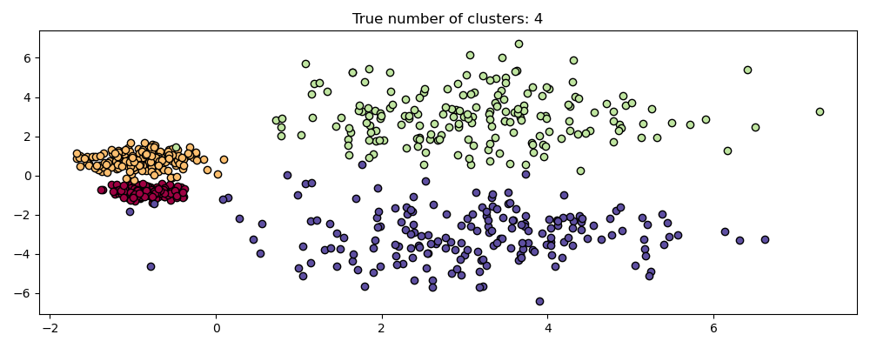
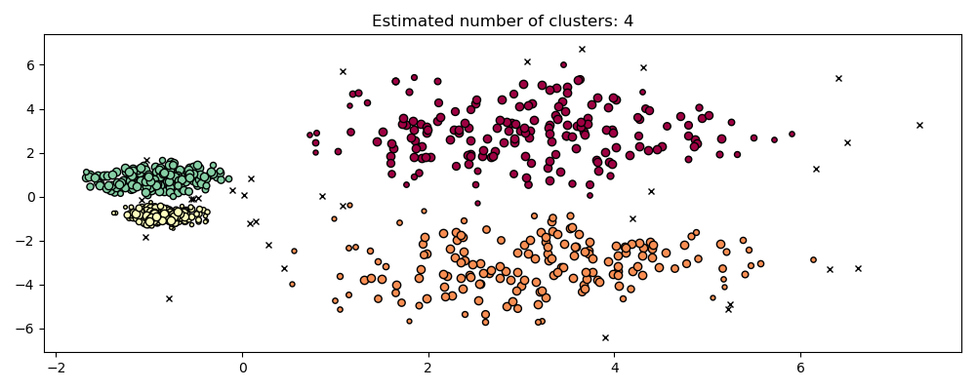
The hdbscan algorithm can be seen as an extension of dbscan and optics
Dbscan assumes that the clustering criterion (i.e. density requirement) is globally homogeneous.
Dbscan may struggle to successfully capture clusters with different densities. hdbscan all eviates this assumption and explores all possible density scales by building an alternative representation of the clustering problem.
HDBSCAN Clustering
from sklearn.cluster import HDBSCAN
hdb = HDBSCAN(min_cluster_size=20)
Y_hdb=hdb.fit_predict(X

Slide 11
HDBSCAN can be smoothed with an additional hyperparameter min_cluster_size which specifies that during the hierarchical clustering,
components with fewer than minimum_cluster_size many samples are considered noise
one can set minimum_cluster_size = min_samples to couple the parameters and simplify the hyperparameter space.

Slide 12
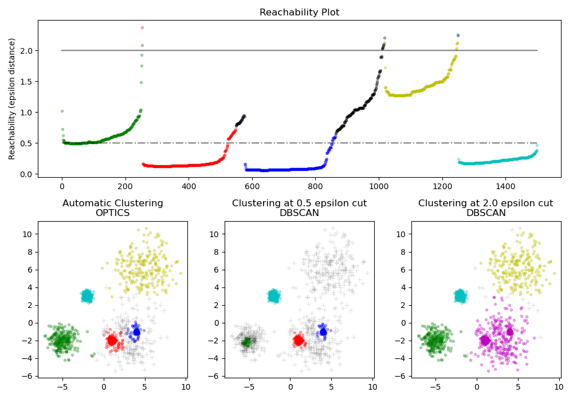
The optics algorithm shares many similarities with the dbscan algorithm.
Can be considered a generalization of dbscan that relaxes The eps requirement from a single value to a value range.
OPTICS CLUSTERING
from sklearn.cluster import OPTICS
opt = OPTICS(min_samples=2)
Y_opt=opt.fit_predict(X

Slide 13
Difference between DBSCAN and OPTICS
OPTICS algorithm builds a reachability graph, which assigns each sample both a reachability_ distance, and a spot within the cluster ordering_ attribute; these two attributes are assigned when the model is fitted, and are used to determine cluster membership.
If OPTICS is run with the default value of inf set for max_eps,
DBSCAN style cluster extraction can be performed repeatedly in linear time for any given eps value using the cluster_optics_dbscan method.
OPTICS Goal
The reachability distances generated by OPTICS allow for variable density extraction of clusters within a single data set.
As shown in the above plot, combining reachability distances and data set ordering_ produces a reachability plot, where point density is represented on the Y-axis, and points are ordered such that nearby points are adjacent.
he reachability plot at a single value produces DBSCAN like results; all points above the ‘cut’ are classified as noise,

Slide 14
OPTICS looks at the steep slopes within the graph to find clusters, and the user can define what counts as a steep slope using the parameter xi.
There are also other possibilities for analysis on the graph itself, such as generating hierarchical representations of the data through reachability-plot dendrograms,
the hierarchy of clusters detected by the algorithm can be accessed through the cluster_hierarchy_ parameter.

Slide 15
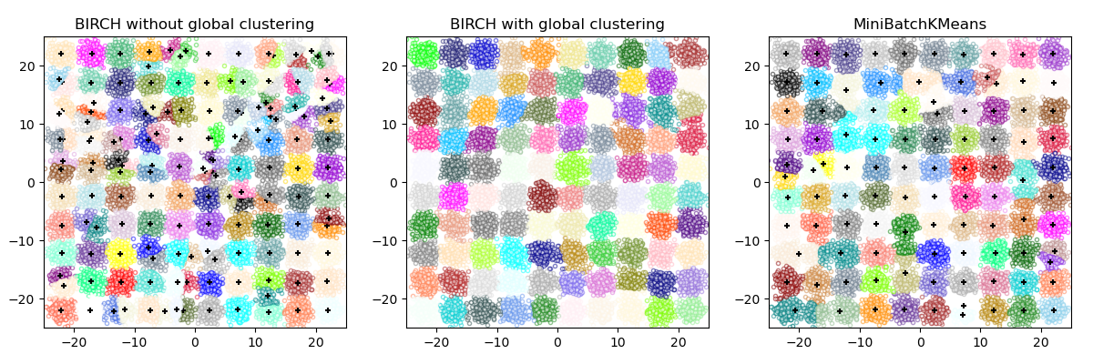
The birch builds a tree called the clustering feature tree (cft) for the given data.
The data is essentially lossy compressed to a set of clustering feature nodes (cf nodes).
BIRCH Clustering
from sklearn.cluster import Birch
bir= Birch(n_clusters=None)
Y_bir=bir.fit_predict(X

Slide 16
The CF Nodes have a number of subclusters called Clustering Feature subclusters (CF Subclusters) and these CF Subclusters located in the non-terminal CF Nodes can have CF Nodes as children.
The CF Subclusters hold the necessary information:
Number of samples in a subcluster.
Linear Sum - An n-dimensional vector holding the sum of all samples
Squared Sum - Sum of the squared L2 norm of all samples.
Centroids - To avoid recalculation linear sum / n_samples.
Squared norm of the centroids.
The BIRCH algorithm has two parameters:
The threshold and the branching factor.
The branching factor limits the number of subclusters in a node
The threshold limits the distance between the entering sample and the existing subclusters.

Slide 17
This algorithm can be viewed as an instance or data reduction method, since it reduces the input data to a set of subclusters which are obtained directly from the leaves of the CFT
This reduced data can be further processed by feeding it into a global clusterer. This global clusterer can be set by n_clusters.
If n_clusters is set to None, the subclusters from the leaves are directly read off, otherwise a global clustering step labels these subclusters into global clusters.
THANK YOU

